Slide 1
SDR Radio Astronomy Receiver
Sponsored by: GVSU Physics Department
Design by: Phil Behnke, Dan Soberal, Sean Bredeweg

Slide 2
What are SDRs?
Analog
Digital
Notes:
Phil
Analog Radio
Fixed Frequency/Bandwidth
Changes in radio parameters require change in hardware.
Everything is analog.
Digital Radio
Get an ADC as close to antenna as possible.
Can instantaneously use multiple channels
Modulation, frequency selection, bandwidth are all defined in software using digital signal processing.

Slide 3

Purpose
Radio Astronomy
Monitoring RF emissions from space
Learn about the Universe and about Earth
Radio Jove
NASA sponsored amateur radio astronomy kit.
Completely analog (Direct Conversion Receiver)
Used to listen to Jupiter (20 MHz)
Redesign Radio Jove to use SDR techniques
Notes:
Dan

Slide 4
Requirements
Operate at 20.1 MHz.
Capture a 1 MHz bandwidth.
100 dB dynamic range.
Capture ~1 microvolt signals from Jupiter.
Be able to record data or analyze data on the fly.
Mix signal to audio and send to headphones.
Notes:
Sean
Early on when the project was first being discussed, we were given a list of requirements for the receiver. Upon further research, some of the requirements were going to be very difficult to achieve the with hardware that was available.
Some of the
We designed our system to operate at a center frequency of 20.1 MHz
After the FPGA approximately 1MHz bandwidth
We were told that we needed to be able to detect a 1 microvolt signal
The LNA, filters, and gain stages amplify the what is desired and attenuate everything else to the noise floor
Be able to record data or analyze data on the fly
To do this we need to transfer the 1 MHz bandwidth in real time to the PC
There are many other requirements that are detailed in the functional specification document. These few listed here are the requirements which greatly influenced the hardware choices in our design.

Slide 5
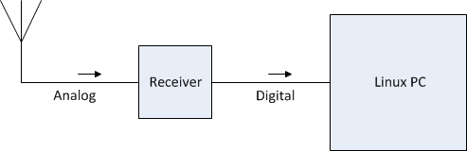
System Overview
Notes:
Phil

Slide 6
Receiver Block Diagram
Receiver
Signal from antenna
RF Front End
Pre-processing
PC running custom DSP software
USB 2.0
Audio converter
Power Switch
Audio output to headphones
Knob to control center frequency
Knob to control output volume
Notes:
Sean
As was depicted in the high level overview of the system in the last slide, the antenna is connected to the receiver which is connected to the pc. Here we have block diagram of the physical receiver which can be split up into three separate blocks: the RF front end, pr-processing block, and the audio converter.
From the diagram we can see that the antenna signal path enters the RF front end, proceeds to the pre-processing block where the signal is then fed to the PC and the audio converter block.
The RF front end is designed to filter the incoming spectrum and amplify the frequency band of interest. Dan will go into further detail about this particular block.
The pre processing block is designed to digitize analog data, perform digital filtering, and pass the data via USB to the PC. I will be speaking about the analog to digital conversion, Dan will touch on the FPGA and Phill will talk about the USB.
The audio converter block is designed to take a very narrow band of the 1MHz bandwidth, mix with an intermediate frequency to audible range, and then output the audio to a head phone jack. The purpose of this is for verification that the receiver is operating when being initially setup. The volume of the audio and center frequency of the audible signal can be adjusted using tuning nobs on the receiver.

Slide 7
RF Front End
 |  |  | Stage
Parameter | Pre-Filter | LNA | GAIN 1 | GAIN 2 | Filter (AA) | GAIN 3
Gain (dB) | -4.67 | 16 | 19 | 19 | -15 | 19
NF (dB) | 0.00053 | 3.5 | 4.3 | 4.3 | 0.00053 | 4.3
IP3 (dBm) | Inf | 13 | 13 | 13 | Inf | 13
P1dB (dBm) | Inf | 2.9 | 22 | 22 | Inf | 22
Notes:
Dan

Slide 8

Noise Analysis
 |  |  | Stage
Parameter | Filter | LNA | GAIN 1 | GAIN 2 | MIXER
Gain (dB) | -5 | 16 | 19 | 19 | 17
NF (dB) | 0.00053 | 3.5 | 4.3 | 4.3 | 5

Slide 9


Dynamic Range
 |  |  | Stage
Parameter | Filter | LNA | GAIN 1 | GAIN 2 | MIXER
Gain (dB) | -5 | 16 | 19 | 19 | 17
IP3 (dBm) | Inf | 13 | 13 | 13 | -13
P1dB (dBm) | Inf | 2.9 | 22 | 22 | NA

Slide 10
Component Selection
Integrated Circuits
LNA = MAX2611, RF Gain = RF2312, Mixer = SA612
Passive Components
Inductors and Capacitors
SRF far away from operating frequency
High Q, Low ESR
Resistors
Thermal Noise

Slide 11
Pre-Filtering
3rd Order Filter Chebyshev Filter
Shunted endpoints
Passband (-3 dB down) = 18 MHz – 22 MHz
Bandwidth is approximately 4 MHz
Attenuation at 15 MHz: 37.8 dB
Attenuation at 25 MHz: 30.1 dB
Notes:
Dan

Slide 12
Anti-Aliasing Filtering
4th Order Butterworth Filter
Mesh capacitor coupled
Passband: 19.4 MHz to 20.6 MHz
Attenuation at 15 MHz: 80.0 dB
Attenuation at 25 MHz: 89.2 dB
Notes:
Dan

Slide 13
RF FRONT END RESULTS
Low Noise Amplifier Stages: 1
Gain Stages: 3
Filters: 2
Total Gain = 53.3 dB
Minimum Discernable Signal = 107 dBm
NF = 3.5828 dB
Noise Floor = 107.417 dBm
Dynamic Range = 88.9 dB
System Attenuation at 25 MHz : 119.3 dB
System Attenuation at 15 MHz: 117.8 dB

Slide 14
Analog to Digital Conversion
RF front end
ADC Driver
LVDS
to
CMOS
ADC
FPGA
ADC Clock
Notes:
Alright, after the RF front end adds gain to the frequency band of interest and attenuates everything outside to the noise floor, the next step is to digitize the data and then send it to the FPGA for analysis.
The ADC is the hardware that bridges the gap between the analog and digital realm. There are several other pieces of hardware that are necessary for the ADC to operate at its peek performance. These include an analog input driver, a high quality clock source, and in our case a LVDS to LVCMOS line driver.
In the next few slides we will take a very brief look at each of these pieces of hardware, as well as the ADC.

Slide 15
Analog to Digital Conversion
ADC Driver – AD8352
Ultra low distortion, low noise RF amplifier
Adjustable common mode
Adjustable gain up to 20dB
Low power
High OIP3 value
Buffered gain setting resister
Convert single ended to differential ended
Notes:
Low noise input stage, 2.7nV per root Hz at a gain of 20dB

Slide 16
Analog to Digital Conversion
ADC Clock Synthesizer –AD9573
100 MHz output when supplied with 25MHz
0.54 ps RMS jitter
Includes a loop filter and regulator for supply noise immunity
Differential output
LVDS/LVCMOS output
Maximum voltage swing of 6.0Vp-p
Notes:
Simple design which requires a 25 MHz input signal and outputs a stable 100MHz signal with 0.54 ps RMS jitter
The ADC requires a differential clock source. It is recommended that the voltage swing not be full scale CMOS as the large voltage swings may induce noise in the ADC.
The synthesizer’s LVDS/LVCMOS output is ideal for the for the clock lines of the ADC.

Slide 17
Analog to Digital Conversion
ADC – AD9460
105 MSPS
78.1 dB SNR
88 dB SFDR
Excellent linearity
LVDS and CMOS compatible
2.0Vp-p to 4.0Vp-p Input
12.7 ENOB
0.06 ps internal jitter
Notes:
We are selecting the 2.0Vp-p input, and the LVDS outputs of the ADC. This is because dynamic performance, including SNR and SFDR, are maximize when LVDS mode is selected.
With an effective number of bit of 12.7, we can expect the actual resolution of the ADC to 300.57 µV between each quantivation level.

Slide 18
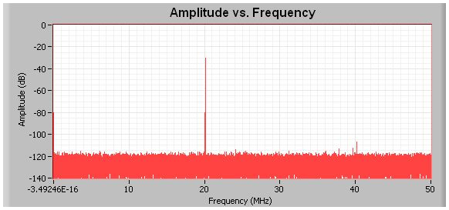
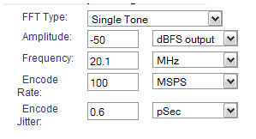
Analog to Digital Conversion
Notes:
Analog devices has a simulation tool that has allowed us see the expected performance of the our particular ADC. Inputting the actual performance specifications, 100MSPS, 0.6 ps rms jitter, 20.1 MHz fundamental frequency, and amplitude relative to the ADC’s full scale capability. Using this tool we can get an idea of the ADC’s actual performance in regards to SNR, SFDR, and distortion.
Performance is also influenced by the quality of components used and the layout of these components. Special care must be taken in the layout of the ADC and its supporting hardware in order for its correct operation.
We have purchased a development board for this ADC directly from analog devices.

Slide 19
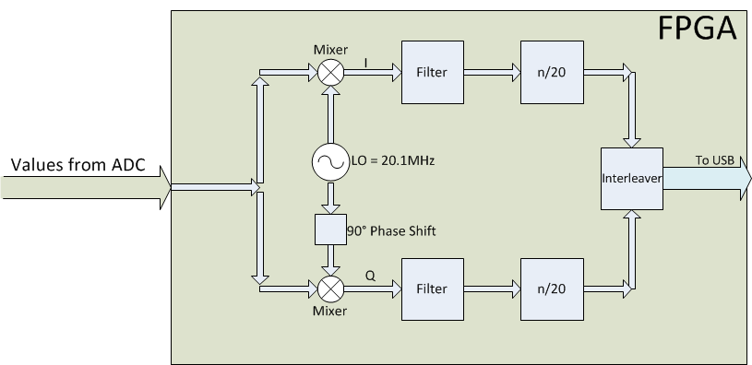
FPGA
19 MHz

Slide 20
Data to the PC
USB
Ethernet
Firewire
Sound Card
Notes:
A USB 2.0 connection will be used to send data from the receiver to the PC.
USB 2.0 has a theoretical maximum speed of 480 Mbps.
USB is ubiquitous.
USB in isochronous mode.
Used for streaming data.
Guaranteed data rate.
No error correction.

Slide 21
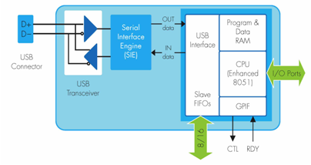
USB
Cypress FX2LP (CY7C68013)
Notes:
Cypress FX2LP USB transceiver.
CY7C68013
Integrated 8051 microcontroller.
Sets up USB interface and “gets out of the way”
Can compile firmware using Small Device C Compiler (SDCC)
Capable of High-Speed (480Mbps)
Four 16 bit FIFO buffers.
Capable of isochronous mode.
No non-volatile memory
Will download code from PC in a process called ReNumeration.

Slide 22
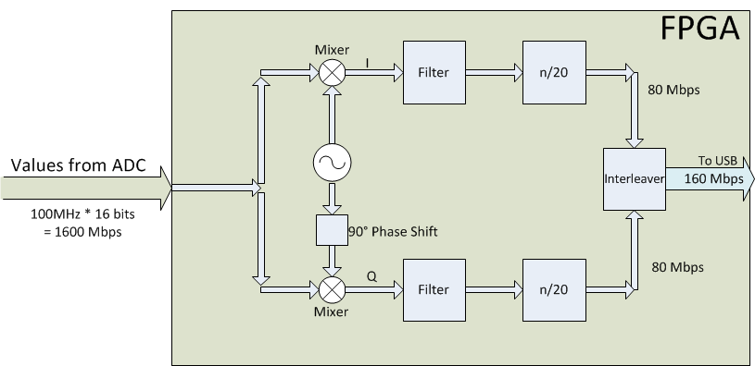
USB Speed
19 MHz

Slide 23
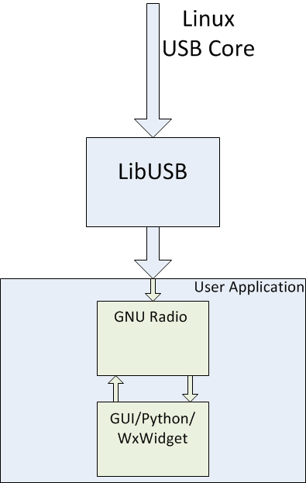

Slide 24
PC
LibUSB
Userland driver!
Supports both bulk isochronous mode.
Used by the USRP of GNU Radio
Several Python wrappers available.
Can go straight from LibUSB to GNU Radio.

Slide 25
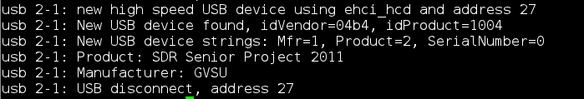
PC

Slide 26
Software Requirements
Real Time Mode | Radio Astronomy Mode | Full Record Mode | Data Analysis Mode
Process to audio | Plot integrated RMS average of live signal energy over entire bandwidth | Save unprocessed data as WAV file. | Process WAV file using Radio Astronomy Mode.
Optionally save audio stream | Export in CSV format. | Display waterfall.
Waterfall plot
Notes:
The PC will perform most of the digital signal processing.
FFT
Waterfall plot
Audio processing
Two Linux USB drivers will be used.
Identify the FX2 and download the correct firmware.
Get the data off the bus.
Second driver will get data off the bus and send it to a TCP socket.

Slide 27
User Application
GNU Radio Backend
Python Frontend

Slide 28
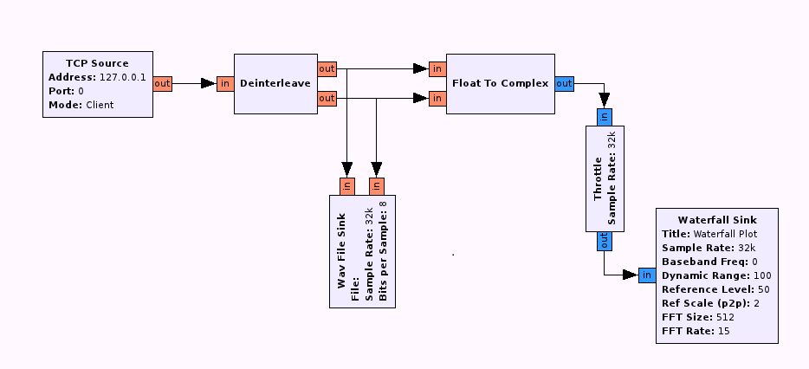
GNU Radio

Slide 29
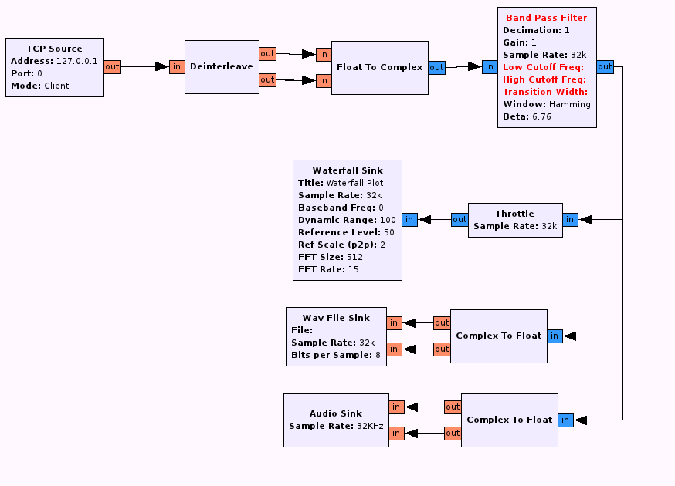

Slide 30
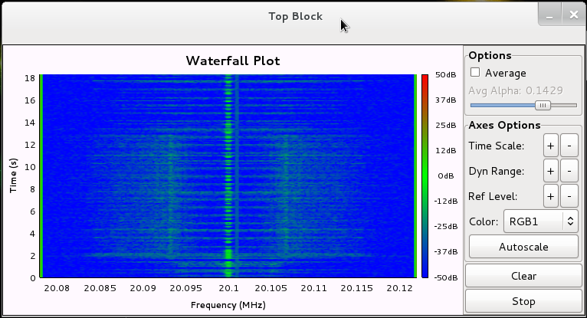

Slide 31
Budget
Front End Components (resistors, capacitors, inductors, connectors, etc): $95
Analog to Digital Converter: $114
FPGA (Nexys II Board): $100
Cypress FX2LP: $17
TOTAL: $326
Notes:
Sean

Slide 32
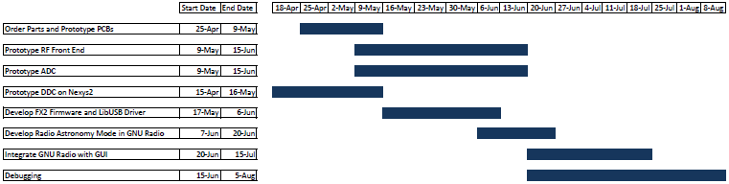
Timeline

